Slide 1

Module – IV : Organization & Team Structure
Software Engineering (SE) → CSEN 3202 – CSE/BTech/6th Semester → Module-IV → Prepared by : Nilina Bera, CSE, HITK

Slide 2
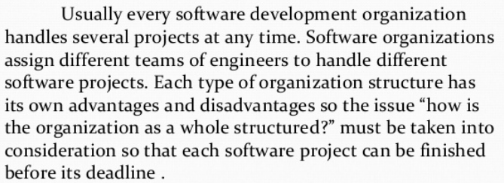
Organization & Team Structure
Nilina Bera

Slide 3
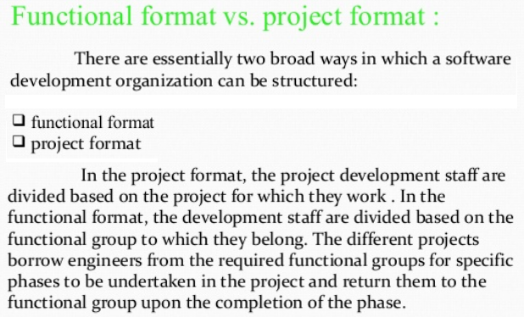


Organization & Team Structure
Nilina Bera

Slide 4
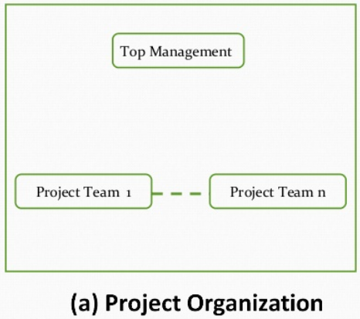
Organization & Team Structure
Nilina Bera

Slide 5
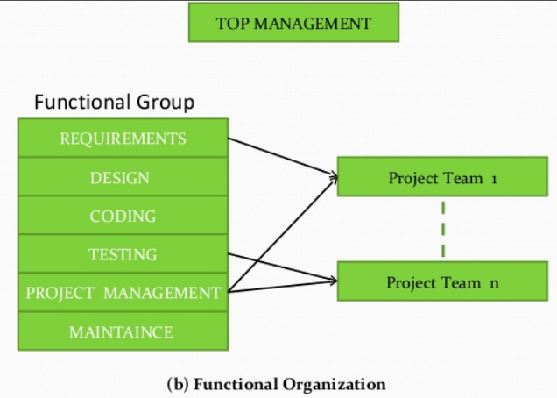
Organization & Team Structure
Nilina Bera

Slide 6
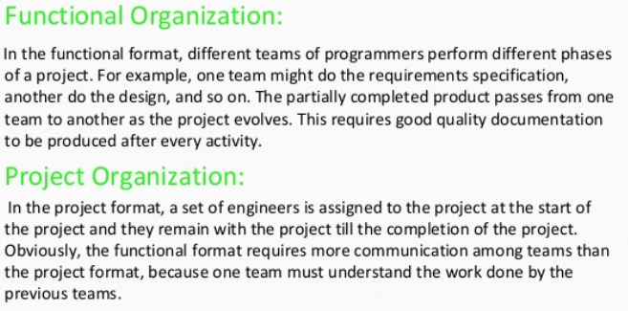
Organization & Team Structure
Nilina Bera

Slide 7
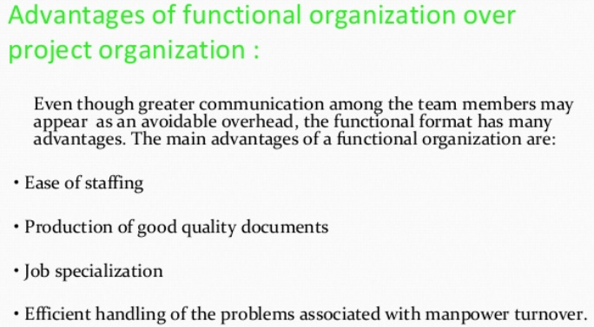
Nilina Bera

Slide 8
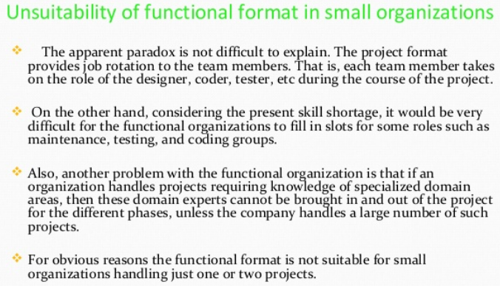
Nilina Bera

Slide 9
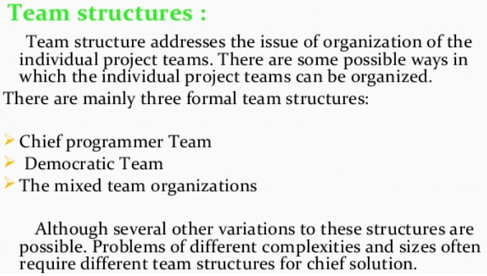
Nilina Bera

Slide 10
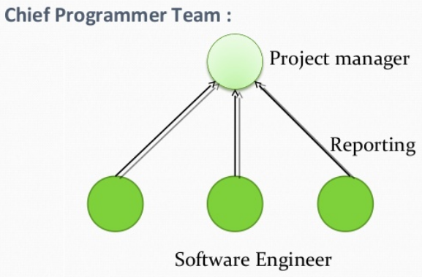
Nilina Bera

Slide 11
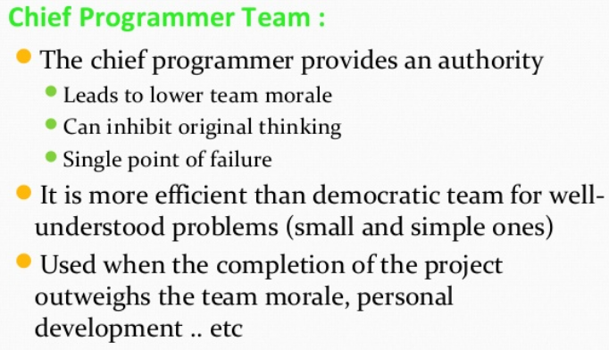
Nilina Bera

Slide 12
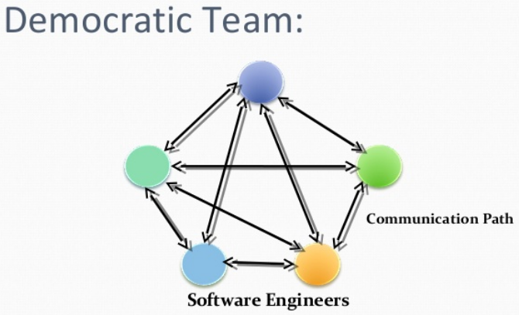
Nilina Bera

Slide 13
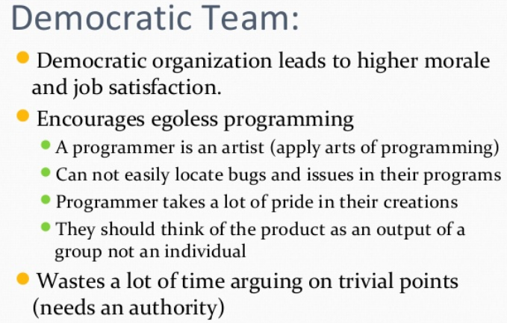
Nilina Bera

Slide 14
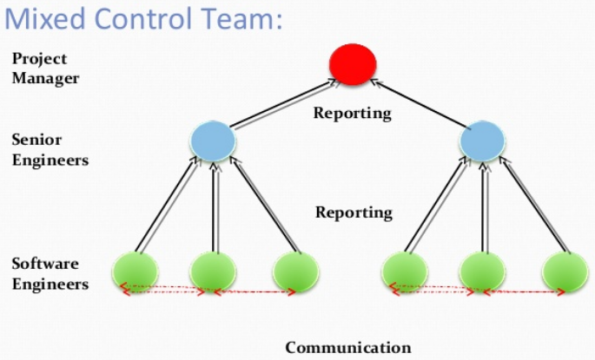
Nilina Bera

Slide 15
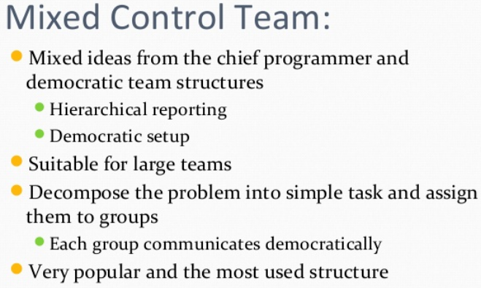
Nilina Bera

Slide 16
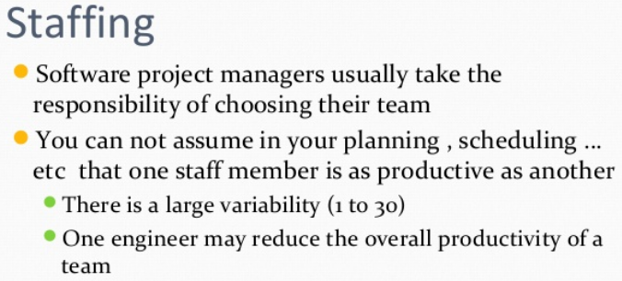
Nilina Bera

Slide 17
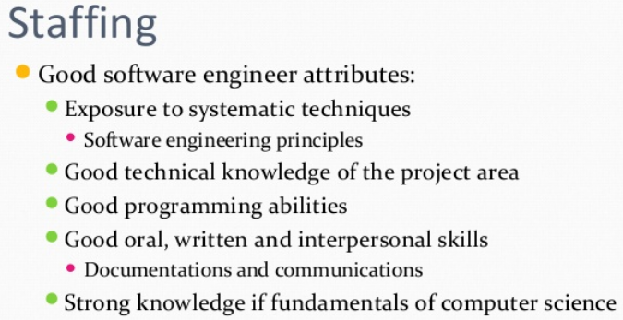
Nilina Bera

Slide 18
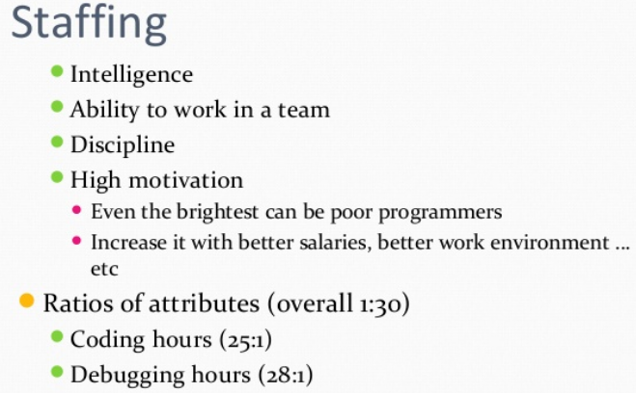
Nilina Bera

